Slide 1
Training Resources and Demonstrations with Python
Paulo Radatz
Engineer Scientist II
EPRI, Knoxville, TN
May 12th, 2022

Slide 2
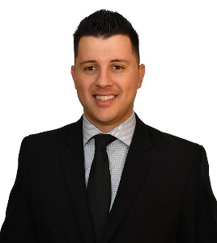
Speaker
Paulo Radatz
Paulo Radatz has worked as Engineer/Scientist at the Electric Power Research Institute (EPRI) in Knoxville, Tennessee, the USA, since 2019. He received both his Master's and Bachelors's degrees in electrical engineering, emphasizing energy and automation, from the University of Sao Paulo, Sao Paulo, Brazil. He was awarded a prize for being the best bachelor's student at the Polytechnic School of the University of Sao Paulo (2015). He has assisted the electric utility industry's transition to tomorrow's distribution platform using a balanced, no-regrets approach to grid modernization with the following topics: hosting capacity, mitigation options to increase hosting capacity, time-series hosting capacity, and DER modeling for QSTS simulation. Currently, he is the leading developer of the EPRI DRIVE tool, and he is one of the OpenDSS developers.
He has seven years of experience with OpenDSS, having taught several OpenDSS trainings in Brazil at conferences, universities, and industry. He is the founder of the largest YouTube channel about OpenDSS in the world. Currently, he lectures about OpenDSS in the Electric Power Distribution MBA course and in the Power System Analysis with OpenDSS course, both at Polytechnic School of the University of Sao Paulo.

Slide 3
Agenda
Training Resources
Virtual Trainings
YouTube Resources
Demonstrations with Python
Why You Might Want to Write Some Code …
What Languages Can You use for Your Code?
OpenDSS Versions
Ways to Write Code to Do Innovative Things
Python integration: py-dss-interface
Example #1: Maximum Load Growth
Example #2: Hosting Capacity Analysis

Slide 4
Training Resources

Slide 5
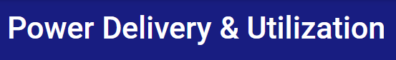

Virtual Trainings
2021 Virtual Training
2020 Virtual Training

Slide 6
YouTube Resources
OpenDSS Basics Playlist
OpenDSS and Python Playlist
OpenDSS-G YouTube Channel

Slide 7
Demonstrations with Python

Slide 8
Why You Might Want to Write Some Code …
Create an algorithm not in OpenDSS
Develop a new device model or control
Automate manual and repetitive tasks
Obtain meaningful results

Slide 9
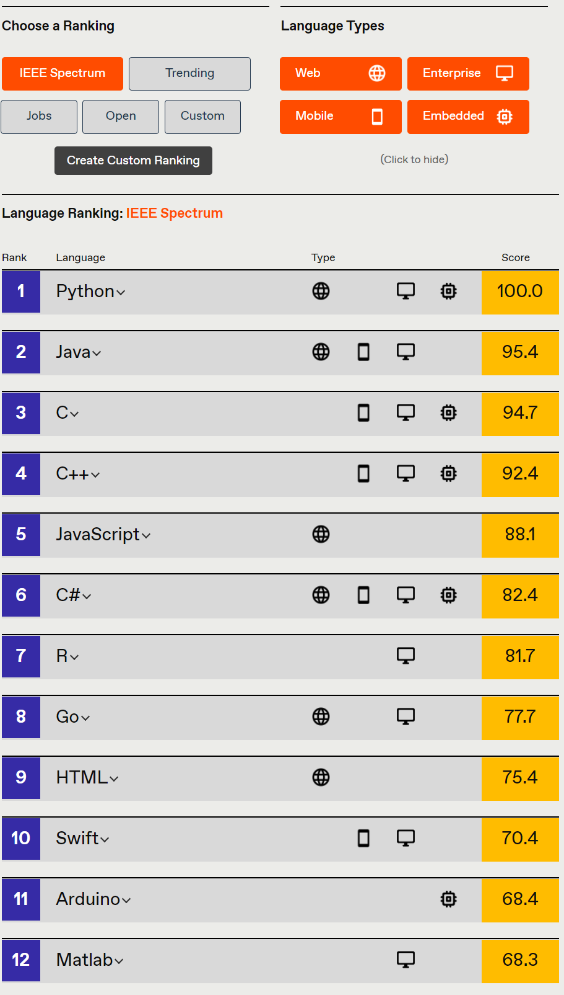
What Languages Can You use for Your Code?
Excel VBA
VB.net
C#
C/C++
Delphi, Free Pascal
MATLAB
Python
Java
LabView
R
Fortran (for DLLs, with DirectDLL)
Julia (with DirectDLL)
Link
Opportunity to use your preferred programming language

Slide 10
OpenDSS Versions
OpenDSS.exe Standalone EXE
OpenDSSEngine.dll In-process COM server
OpenDSSDirect.dll Direct Call DLL
OpenDSSCmd.exe Standalone EXE command line
Available in 32-bit and 64 bit
KLUSolve.dll, “sparse matrix solver”
DSSView.exe, external program to process output results

Slide 11
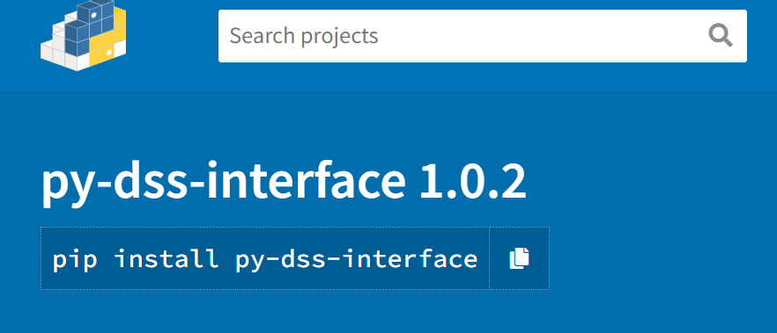
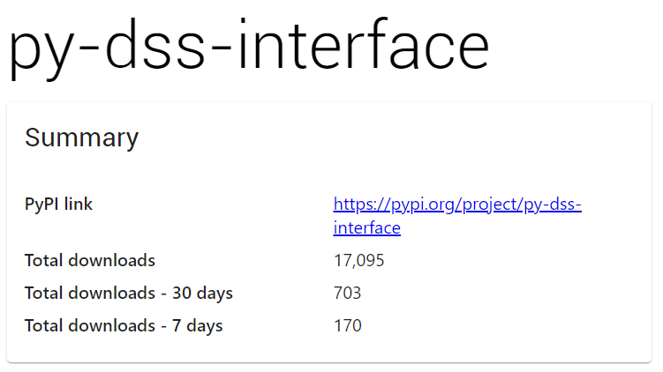
Python integration: py-dss-interface
Python Package
Uses the official OpenDSS DirectDLL version
Version 9.3.0.1 comes with the Package
Users can use their OpenDSS version as well
Created based on Direct connection Shared Library (DLL) for OpenDSS doc by Davis Montenegro
Installing from PyPI
pip install py-dss-interface
Examples
https://pepy.tech/project/py-dss-interface

Slide 12
Example #1: Maximum Load Growth

Slide 13
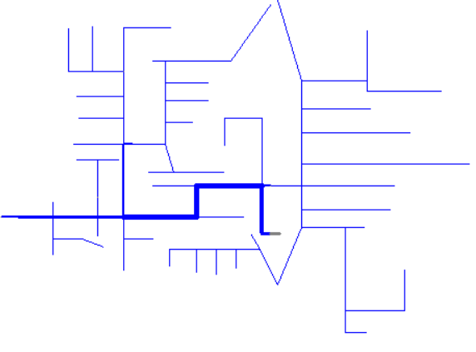
Study Objectives
Determine the maximum load growth without the feeder experiencing Undervoltage
Process
123Bus
Define baseline scenario
While not undervoltage
Increase all load sizes equally with a 1% value
Perform a snapshot simulation
Obtain the minimum voltage across the feeder
Compare the minimum voltage with the Undervoltage threshold of 0.95 pu
When Undervoltage
Result is the load growth in % value of the previous iteration
Feeder head

Slide 14
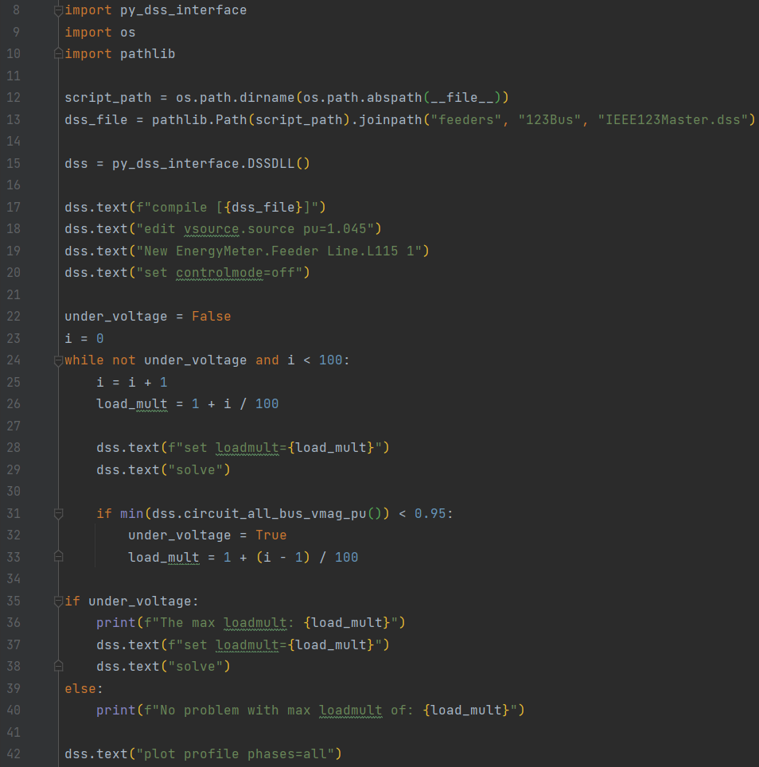
Python Script
Importing Python Packages
Selecting dss model
Creating dss object
Changing model to provide more interesting results
Load growth and power flow
Checking for violation
Results

Slide 15
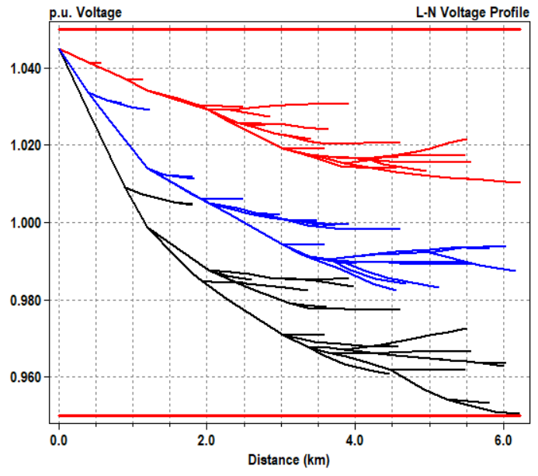
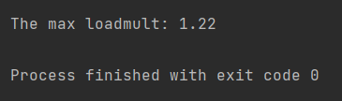
Results
22% load growth without experiencing undervoltage

Slide 16
Example #2: Hosting Capacity Analysis

Slide 17
What is Hosting Capacity?
Hosting capacity is defined as an estimate of the amount of DER that can be accommodated anywhere on the distribution system without adversely impacting power quality or reliability under existing control configurations and without requiring infrastructure upgrades.
The Hosting Capacity Process: https://www.epri.com/research/products/000000003002019750
EPRI’s Distribution Resource Integration and Value Estimation (DRIVE) Tool :
https://www.youtube.com/watch?v=n4papbQWp28&t=17s
https://www.epri.com/research/products/000000003002023086
Hosting Capacity Guidebook: 2021 Edition: https://www.epri.com/research/products/000000003002021527

Slide 18
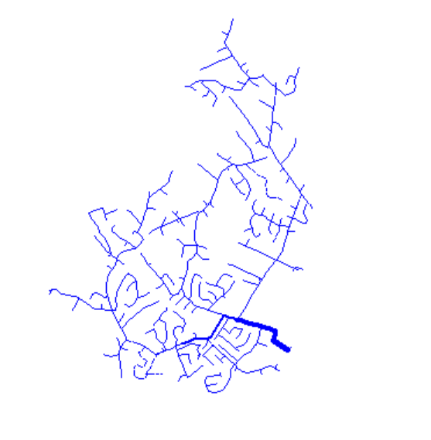
Feeder
Ckt5
Voltage regulating devices
Regulators are off
Capacitors are off
Feeder head
Ckt5 EPRI Test Circuit

Slide 19
Study Objectives
Provide the histogram of Overvoltage Centralized Hosting Capacity for generation results for all three-phase medium voltage buses.
Simulation
Data Analysis
Perform the centralized hosting capacity process considering overvoltage as the only metric
Obtain OV HC for each 3-ph MV bus
Plot the histogram of the OV HC for all considered buses

Slide 20
Simulation Part
Process
Compile Circuit
Get all 3-ph MV buses
For each bus
Compile circuit
Set baseline
Run OV HC process
Save OV HC
Save (Buses; OV HC results)

Slide 21
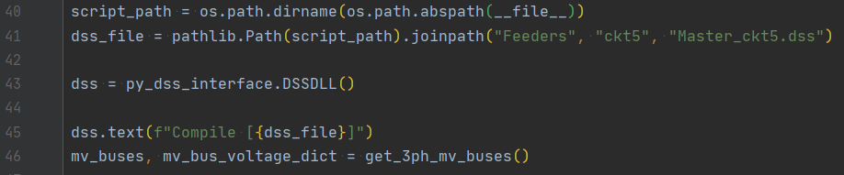
Process (process_hc.py)

Slide 22
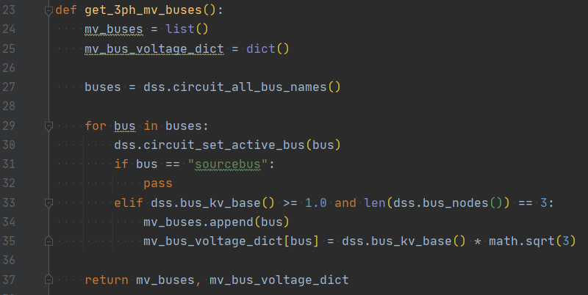
Process (process_hc.py)

Slide 23
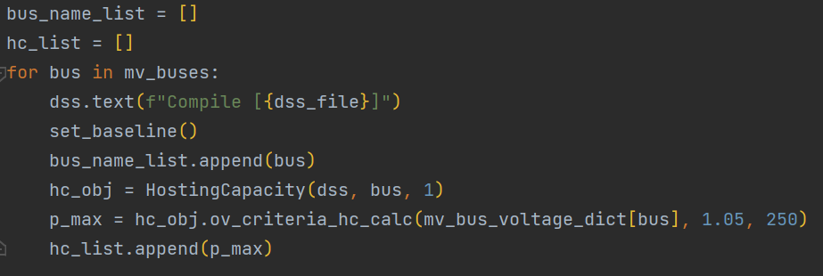
Process (process_hc.py)

Slide 24
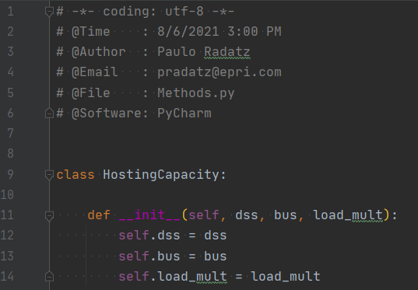
Process (process_hc.py)

Slide 25
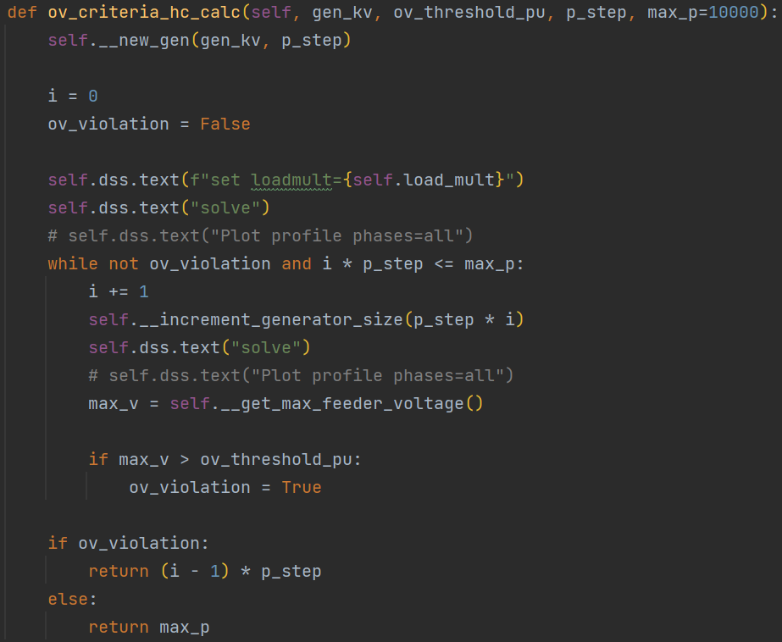
Process (process_hc.py)

Slide 26
Process (process_hc.py)

Slide 27
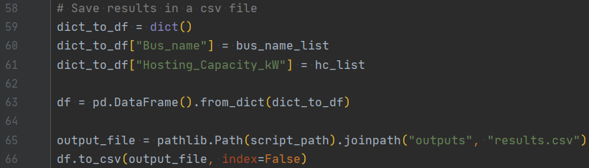
Process (process_hc.py)
“…\HostingCapacity_OpenDSS\outputs\results.csv"

Slide 28
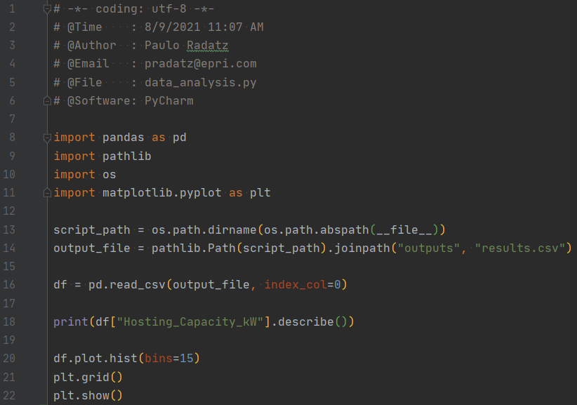
Data Analysis (data_analysis.py)

Slide 29
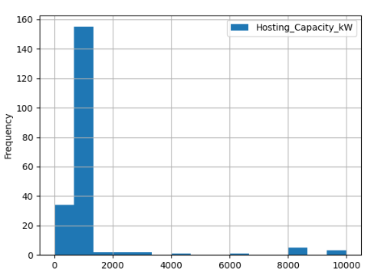
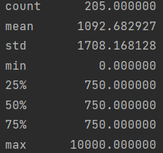
Data Analysis (data_analysis.py)

Slide 30
Thank you! Questions?

